Slide 1

Final Project
Xin Gao

Slide 2
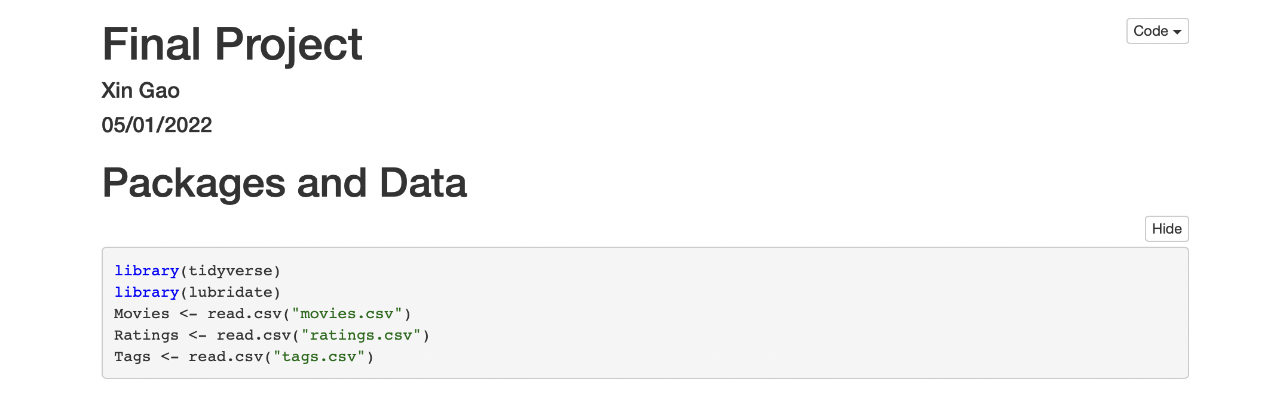
Packages and Data

Slide 3
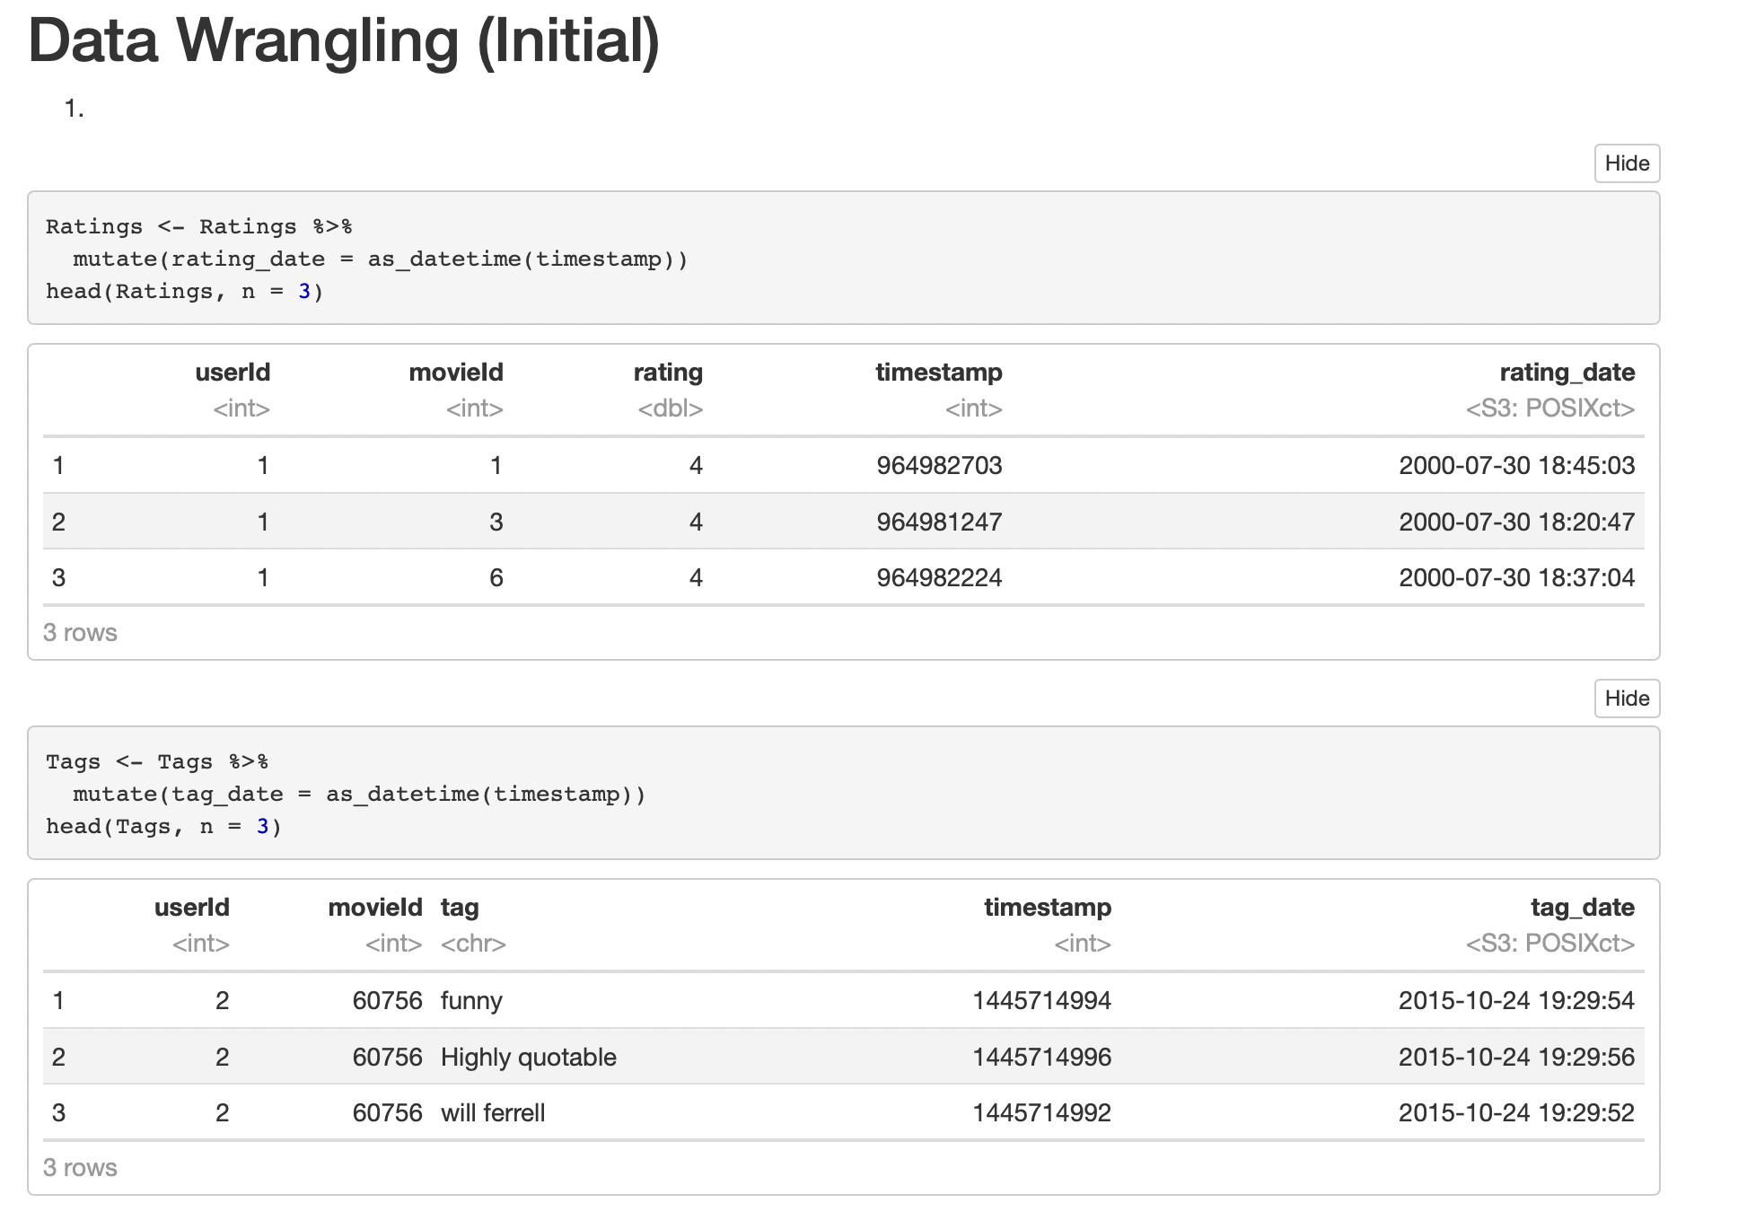
Data Wrangling (Initial)

Slide 4
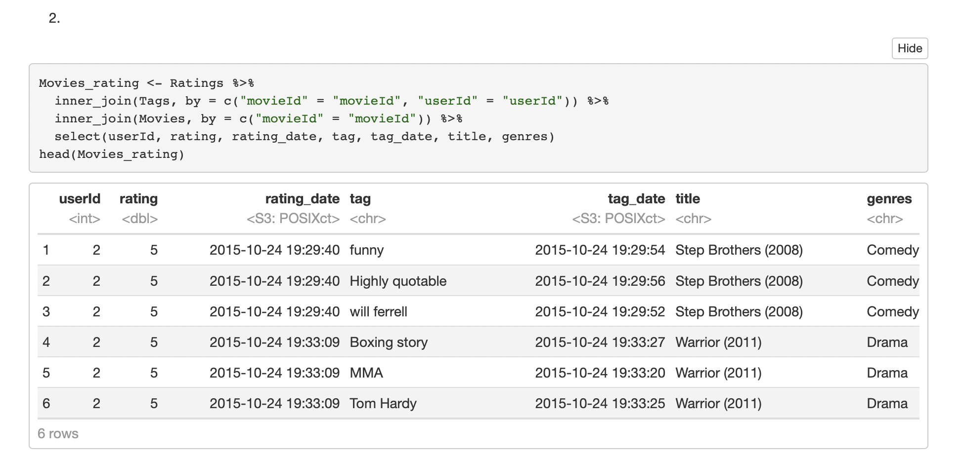
Data Wrangling (Initial)

Slide 5
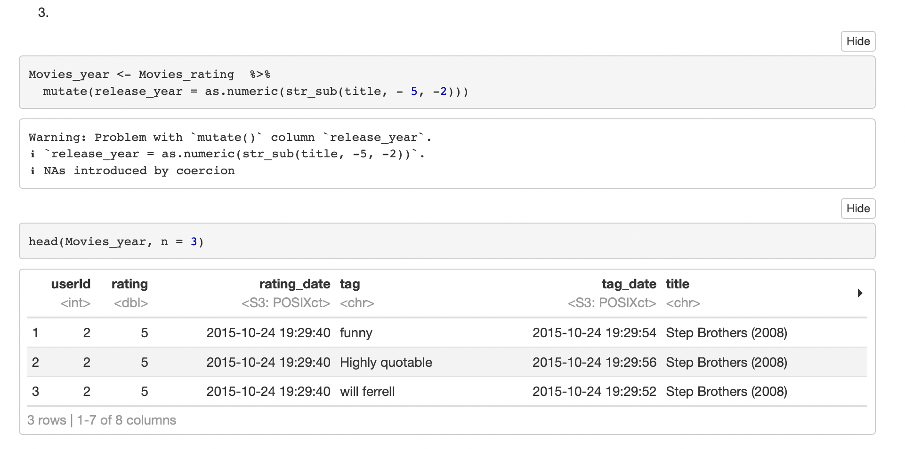
Data Wrangling (Initial)

Slide 6
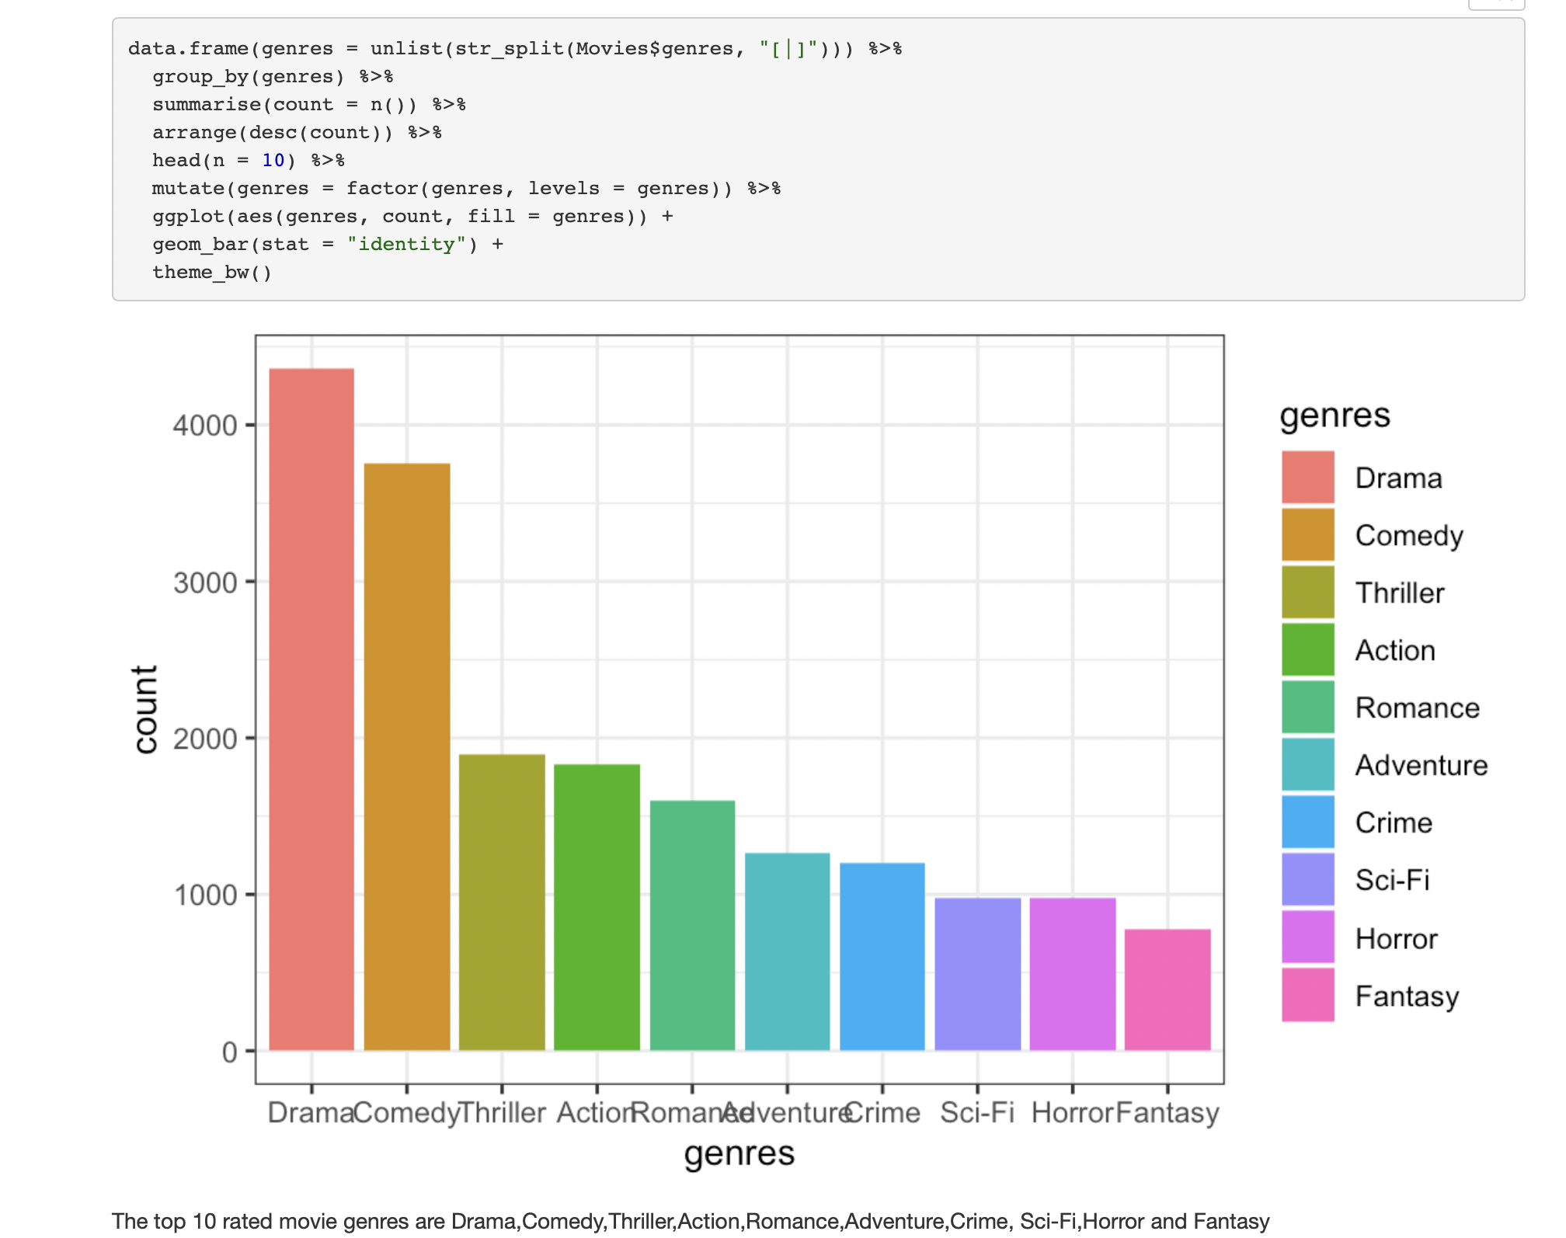
Data Visualization

Slide 7
What were the top 10 rated movie genres?
The top 10 rated movie genres are Drama, Comedy, Thriller, Action, Romance, Adventure, Crime, Sci-Fi, Horror and Fantasy.

Slide 8
Data Visualization
What are the top ten movies rated by more than 50 people?

Slide 9
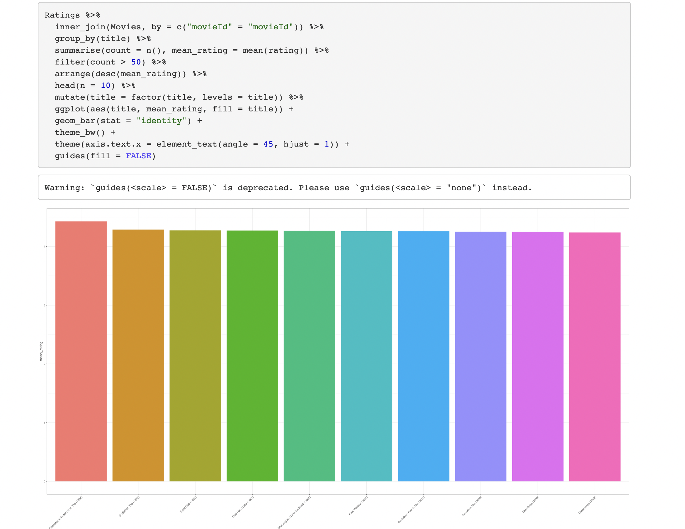
Data Visualization

Slide 10
Thoughts of the project
I found that data wrangling part is the most challenging thing when I am doing the project.
I have learned that how to use ggplot to create the graph correctly, and how to create a new data object that joins data by doing the project.

